Slide 1

Portfolio Milestone
By: Matthew Laken
Spring 2022

Slide 2

Who Am I?
Undergraduate
Graduate of The University of Maryland, College Park School of Information Studies, Bachelor of Science in Information Science, May 2020.
Masters
Enrolled in Syracuse University Master of Applied Data Science Program, Fall 2020.
Completion of Master of Applied Data Science Program, Spring 2022.
Objective
Expand the application for information and data science by digging deeper.

Slide 3




My Course Highlights:
IST 659: Database Administration
IST 687: Introduction to Data Science
IST 707: Data Analytics
IST:652 Scripting for Data Analysis

Slide 4

IST 659: Database Administration
Goal: Fundamentals of databases; compiling datasets, building tables, writing queries and storing models.
Professor: Chad Harper
Date: Fall 2020
Software: Microsoft SQL, Access, Excel, R (R Studio)

Slide 5
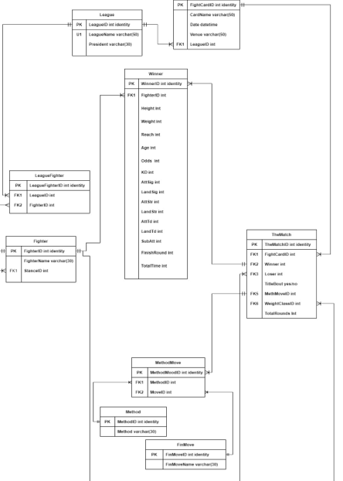

UFC Relational Database Ultimate Fighting Championship
Purpose: Develop a logical relational database to store information on UFC fighters and the results of their matches to gain insight into the sport.
Data Source: http://ufcstats.com/
Deliverable: Comprehensive report including the logical model of the database, questions, views/functions, and evaluation.

Slide 6
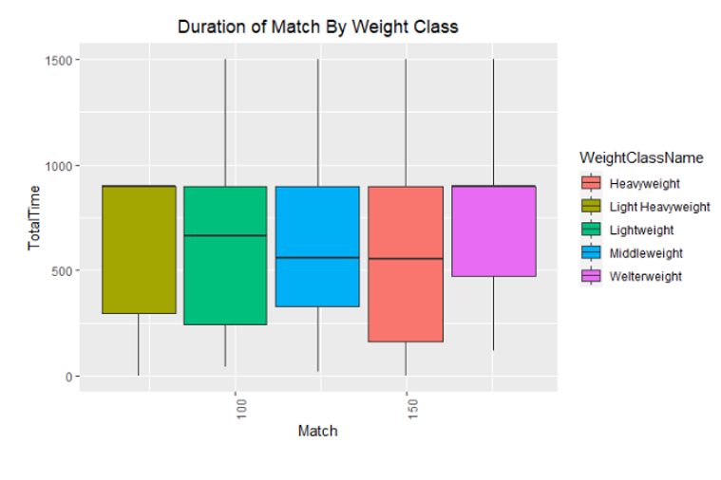
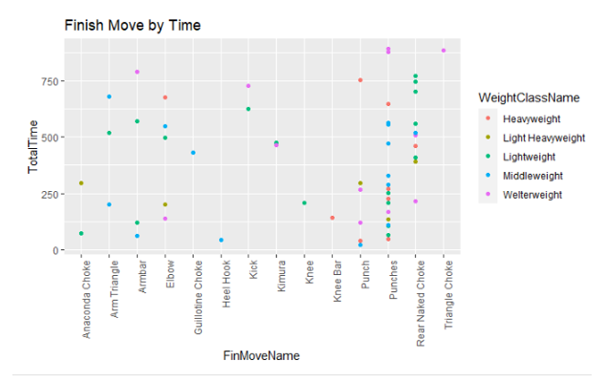
Analysis
Aggregated data by Weight Class:
Analyzed aspects of the match to observe the differences between the different divisions.
Concluded the following:
Heavyweight matches end earlier than others, and they throw fewer strikes compared to other divisions.
Majority of fights that are stopped early result in the winner by punches.

Slide 7

Learning Outcomes
Collect, clean data, and develop a database.
Understand database development lifecycle.
Construct, analyze, and solve business problems by using SQL language to create and run queries.
Enforce integrity of data/database through database design and implementation.

Slide 8

IST 687: Introduction to Data Science
Goal: Exploring the key components of data science by expanding on knowledge of spreadsheets to utilize R to answer business problems.
Professor: Jeffery Saltz / Tin Hoang
Date: Fall 2020
Software: R (R Studio), Microsoft Excel

Slide 9

Project: Analysis of Cost and Salary Potential of Attending College
Purpose: Analyze the cost of going to college and one's salary potential upon graduating to determine the most cost-beneficial schools to attend.
Data Source: https://www.kaggle.com/jessemostipak/college-tuition-diversity-and-pay?select=salary_potential.csv
Deliverable: Comprehensive report including methods of analysis and evaluation.

Slide 10
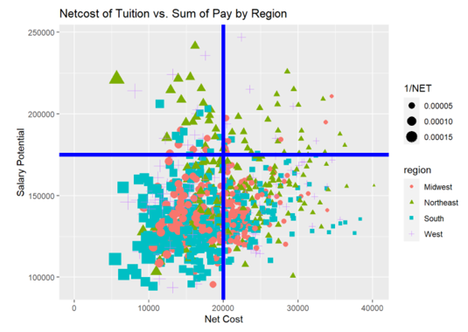
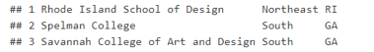
Analysis
Ability to determine which schools have the lowest cost and the greatest potential for salary.

Slide 11
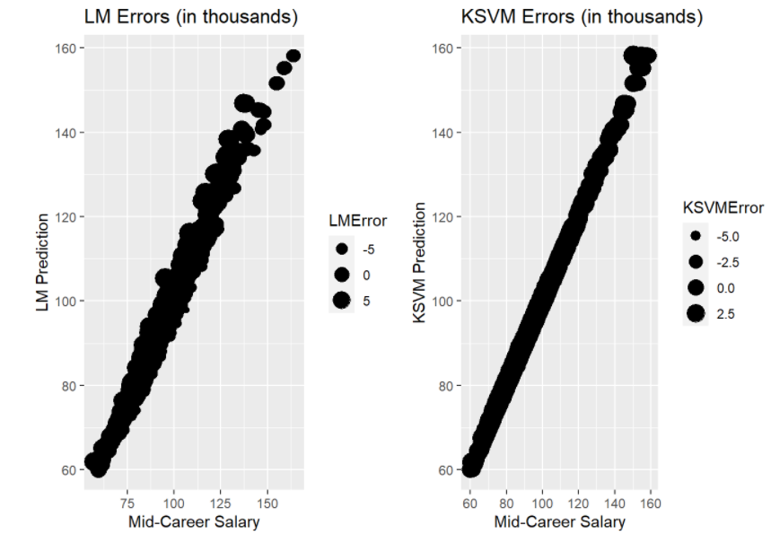
Analysis
Can we predict the mid-salary career based on where they go to school?
KSVM model tracks closer to the true data than the linear model.
Both models have about the same overall error.
The narrower range of error makes the KSVM more accurate, but the linear model runs much faster.
Either model seems sufficient to predict mid-career salary.

Slide 12

Learning Outcomes
Fundamentals of data management using R and R-Studio such as data processing, cleaning, and merging.
Identify a problem and the components needed for analyzing and communicating results.
Collaborate within a team setting to walk through the various stages of a project life-cycle and carry out a finalized product.
Determine appropriate techniques for analyzing data.

Slide 13

IST 707: Data Analytics
Goal: Utilize the tools and methods of data mining while introducing its real-world application to solving problems in business.
Professor: Stephen Wallace
Date: Spring 2021
Software: R (R Studio), Weka, Orange, Alteryx, Excel

Slide 14

Project: Marvel vs DC Analysis
Purpose: Experiment with various classification methods, by comparison, analyzing data on Superheroes and Villains from Marvel and DC Comics.
Data Source: https://www.kaggle.com/dannielr/marvel-superheroes
Deliverable: Comprehensive report detailing the methods, proposed questions, and results of the experiment.

Slide 15
Analysis
Using SVM, kNN, Random Forest, and Naïve Bayes to determine which model is most accurate in classifying the characters.
3-fold cross validation to determine how they can predict publisher and alignment for the power dataset, the rating statistics dataset, and the combined dataset.
SVM algorithm yielded the greatest percent of classification accuracy.
Experiment | SVM CA
Experiment 5: Predict Publisher with Master Dataset | 69.1%
Experiment 6: Predict Alignment with Master Dataset | 68.2%

Slide 16


Learning Outcomes
Document, analyze, and translate data mining needs into technical designs and solutions.
Apply data mining concepts, algorithms, and evaluation methods to real-world problems.
Employ data storytelling and dive into the data, find useful patterns, and articulate what patterns have been found, how they are found, and why they are valuable and trustworthy.

Slide 17

IST 652: Scripting for Data Analysis
Goal: Comprehend the tools and skills of scripting to utilize data science while solving real-world problems by analysis or visualization.
Professor: Dr. Debbie Landowski
Date: Summer 2021
Software: Python, Excel

Slide 18

Project: MLB Strikeout Investigation
Purpose: Collaborate with peers to write Python scripts to
investigate data and communicate findings utilizing the techniques for processing data. This is demonstrated using baseball metrics from the pybaseball package analyzing strikeouts throughout history.
Data Source: https://pypi.org/project/pybaseball/
Deliverable: Comprehensive report detailing an initial plan for the group project. Complete with the demonstration of written Python scripts to access, prepare and use data to produce data summaries, lists, and other structures.

Slide 19
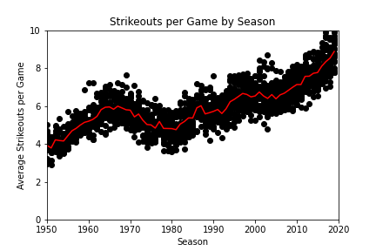
History
Over 70+ years of historical data in the MLB season.
More than 700,000 pitches are thrown in each season.
Strikeouts have risen significantly since 1980 and continue to increase.
An overview of how Strikeouts per game has changed based on significant events over the past 70 years.
Strike zone enlarged 1963-68
Designated hitter rule took effect
Mitchell report on steroids
Changes with Substance policy 2021 Season

Slide 20
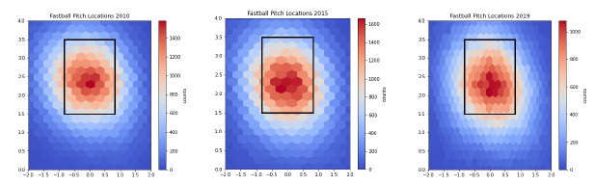
Analysis
The rise in strikeouts and homeruns can be attested to the way pitchers have gradually raised where they throw fastballs in the strike zone over the past 10 years.

Slide 21
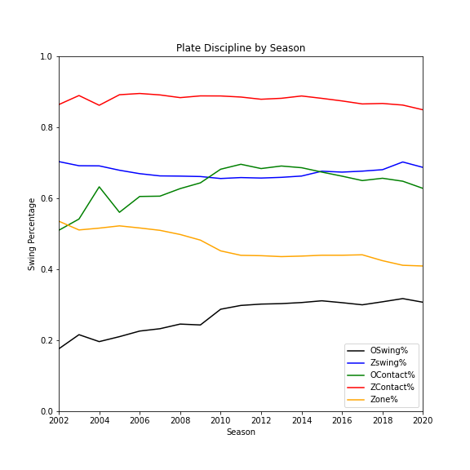
Analysis
Aggregated data on the players by year to determine how disciplined hitters are.
More pitches outside the zone = swinging at more pitches out of the zone.
Rising strikeouts and decreasing batting averages.
Pitchers are forcing hitters to swing at more pitches outside of the strike zone thus more strikeouts, lower batting average.

Slide 22

Learning Outcomes
Develop python scripts to access information from files of structured data, access files in semi-structured data, and find patterns in unstructured data.
Prepare and transform data to produce data summaries, lists, and networks utilizing appropriate software packages that can be integrated into the problem solution.
Analyze and solve data access problems for the three types of data, to find and frame real-world data questions and show how they can be answered with data.

Slide 23

Thank you!
To review these projects in detail as well as additional information about my studies in this Master’s program please check out my GitHub and LinkedIn. I am always open to new connections and conversations!

